Slide 1
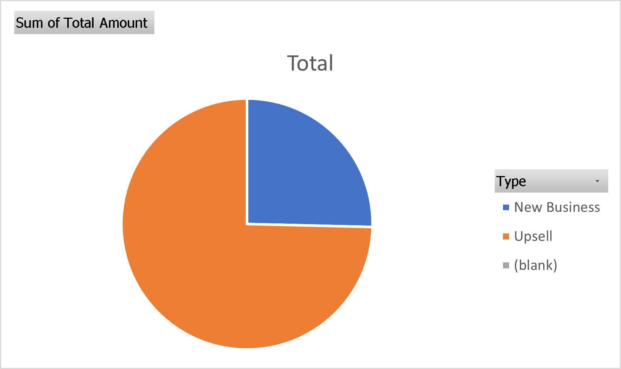
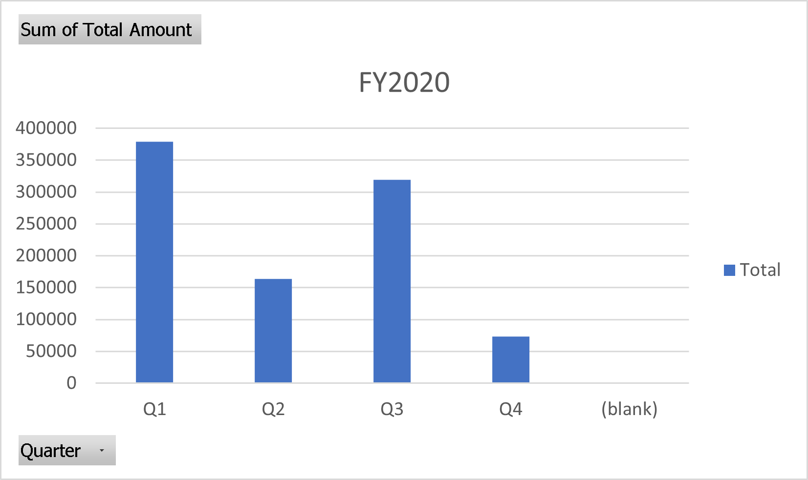
Acme Corporation
FY2020 Overview
Quarter Overview
New Business/Upsell

Slide 2
Acme Corporation
New Business
Account Number | Contact Name | Billing State | Type | Quarter | Total Amount
139519986 | Deborah Mangan | Texas | New Business | Q3 | $17,274.74
207008307 | Murry Cornforth | Oregon | New Business | Q1 | $26,746.18
220999168 | Nadeen Regelous | Minnesota | New Business | Q1 | $43,199.58
271329976 | Suellen Algar | New York | New Business | Q4 | $32,613.53
353867246 | Kimberlee Erington | Virginia | New Business | Q3 | $27,686.09
554198664 | Cheri Castelli | Michigan | New Business | Q2 | $73,077.12
905504121 | Katheryn Cardo | New Jersey | New Business | Q1 | $16,838.60

Slide 3
Acme Corporation
Upsell

